Slide 1
Salary Prediction
By Ruddhi Rani

Slide 2
Content
Introduction
Exploratory Data Analysis
Feature Engineering
Data Preprocessing
Model Development
Model Evaluation
Deployment
Recommendations
Conclusion
A overview of slide structure

Slide 3
Introduction:
Salaries in the field of data professions vary widely based on factors such as experience, job role, and performance.
Accurately predicting salaries for data professionals is essential for both job seekers and employers.
This analysis aims to build a predictive model for salaries of data professionals.

Slide 4
Exploratory Data Analysis
Understand the dataset structure.
Identify patterns and relationships in the data.
Summarize statistics and visualize key insights.
Objective of EDA

Slide 5
Steps of Exploratory Data Analysis :
Summary Statistics:
Descriptive statistics for numerical columns.
Count and unique values for categorical columns.
Missing Values Analysis:
Identify columns with missing values.
Determine the proportion of missing values in each column.

Slide 6
Steps of Exploratory Data Analysis :
Visualizations:
Distribution of Salaries:
Histogram to visualize the distribution of the target variable SALARY.
Relationships with Numerical Features:
Scatter plots for SALARY vs. AGE, LEAVES USED, LEAVES REMAINING, RATINGS, PAST EXP.
Categorical Variables:
Count plots for SEX, DESIGNATION, and UNIT.

Slide 7
Visualizations

Slide 8
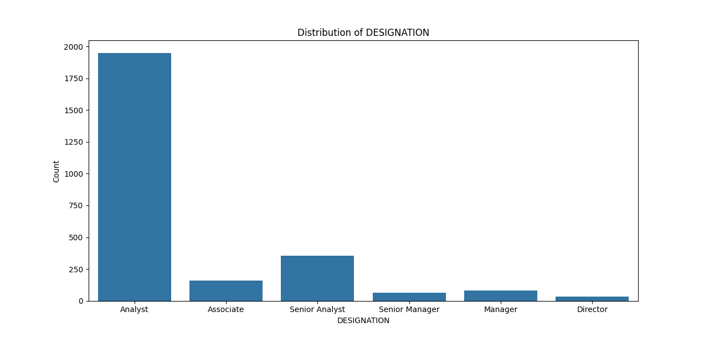
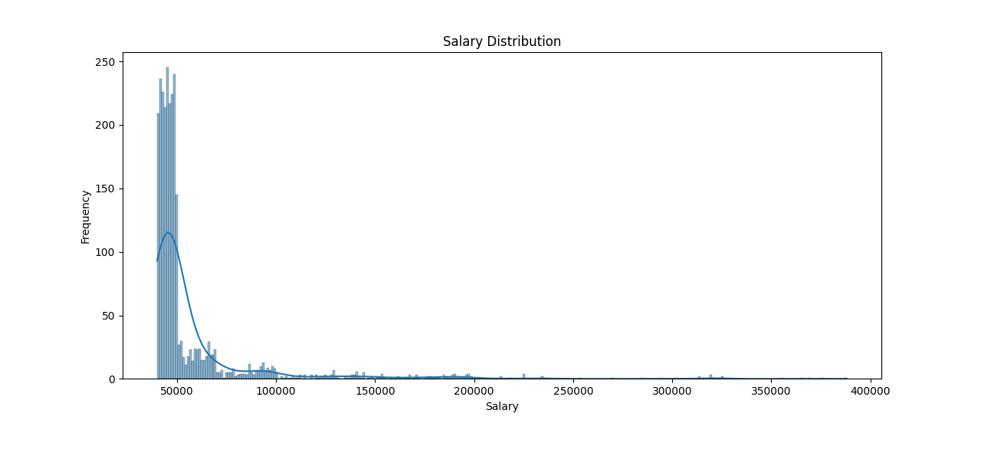

Slide 9
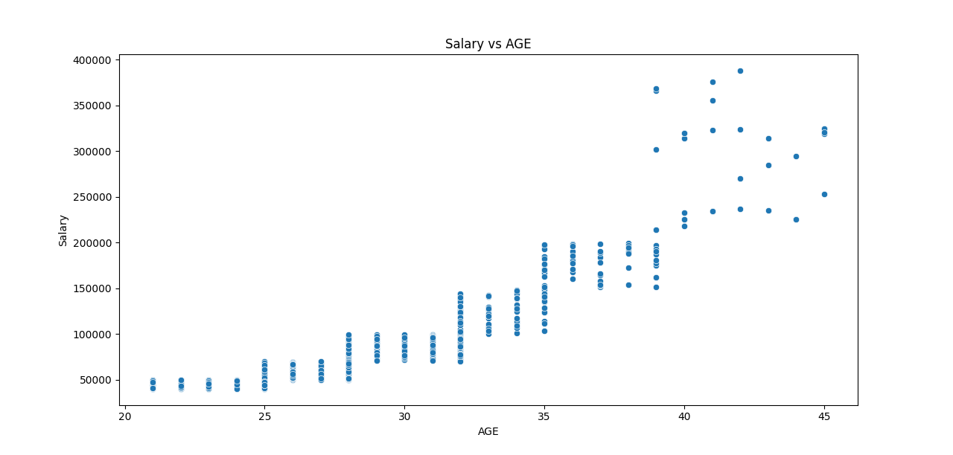
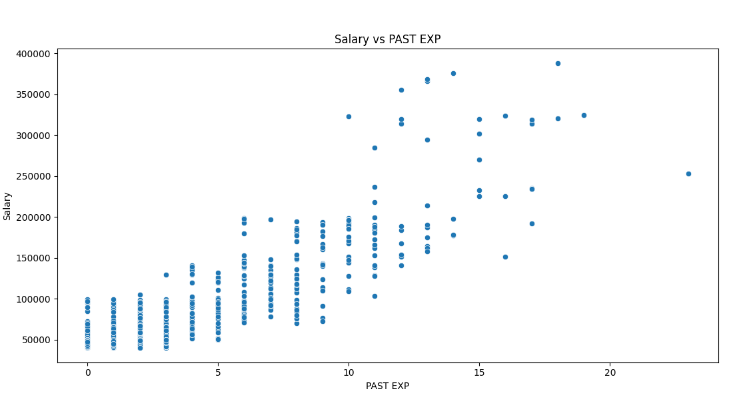
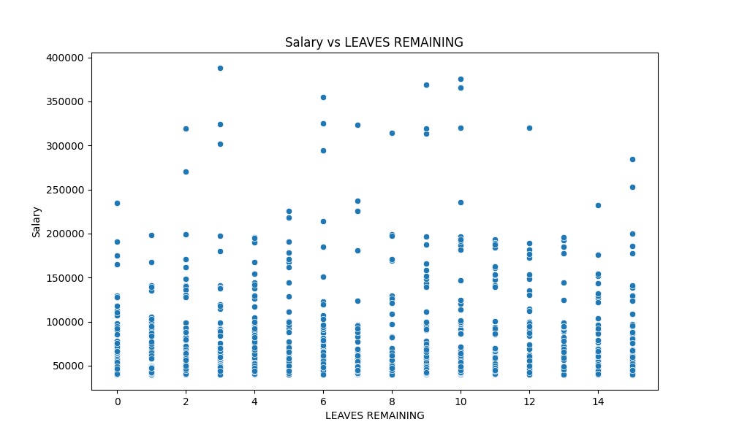
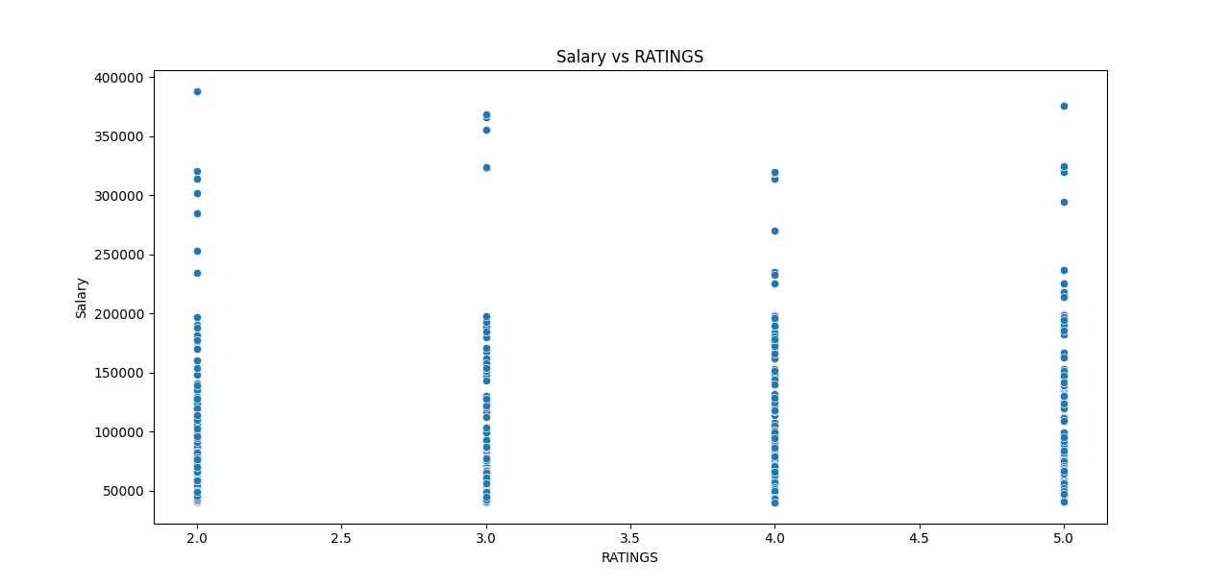

Slide 10
Feature Engineering
Create new features to enhance model performance.
Transform existing features to provide additional insights.
Objective of FE

Slide 11
Steps of Feature Engineering:
Date Features:
Calculate TENURE from DOJ and CURRENT DATE to represent the duration of employment in years.
Categorical Features:
Ensure categorical features are treated as strings for proper encoding.

Slide 12
Steps of Feature Engineering:
Interactions and Transformations:
Consider interaction terms or polynomial features if necessary.
Example: Interaction between PAST EXP and RATINGS could be insightful.

Slide 13
Data Preprocessing
Prepare the data for model training.
Handle missing values, encode categorical variables, and scale features.
Objective of DP

Slide 14
Steps of Data Preprocessing:
Handling Missing Values:
Impute missing values using appropriate strategies (e.g., median for numerical features, constant for categorical features).
Encoding Categorical Variables:
Use OneHotEncoder for SEX, DESIGNATION, and UNIT.
Scaling Numerical Features:
Apply StandardScaler to standardize numerical features.

Slide 15
Machine Learning Model Development
Train various machine learning models to predict salaries.
Experiment with different algorithms to find the best-performing model.
Objective of MLMD

Slide 16
Necessary Algorithms :
Linear Regression: A simple and interpretable algorithm that models the relationship between the target and predictor variables as a linear equation.
Decision Tree Regression: A non-linear model that splits the data into subsets based on feature values, creating a tree-like structure to make predictions.

Slide 17
Necessary Algorithms :
Random Forest Regression: An ensemble method that builds multiple decision trees and averages their predictions to improve accuracy and reduce overfitting.
Gradient Boosting Regression: An advanced ensemble technique that builds trees sequentially, each one correcting the errors of the previous, to enhance predictive performance.

Slide 18
Steps of Model Development :
Model Training:
Split the data into training and testing sets.
Train each model on the training set.
Hyperparameter Tuning:
Use techniques like GridSearchCV for tuning hyperparameters.

Slide 19
Model Evaluation
Assess the performance of the models using appropriate metrics.
Identify the model that provides the most accurate salary predictions.
Objective of ME

Slide 20
Evaluation Metrics :
Mean Absolute Error (MAE): Measures the average magnitude of errors in predictions, providing a straightforward measure of model accuracy.
Mean Squared Error (MSE): Squares the errors before averaging, penalizing larger errors more heavily, thus highlighting significant deviations.

Slide 21
Evaluation Metrics:
Root Mean Squared Error (RMSE): The square root of MSE, providing an error metric on the same scale as the target variable, making interpretation easier.
R-squared (R²) score: Indicates the proportion of variance in the target variable explained by the model, showing the goodness of fit.

Slide 22
Steps of Model Evaluation :
Model Comparison:
Compare the models based on the evaluation metrics.
Identify the best-performing model.

Slide 23
Model | MAE | MSE | RMSE | R²
Linear Regression | 4658.09 | 9.70e+07 | 9848.89 | 0.9416
Decision Tree | 5466.57 | 1.82e+08 | 13480.66 | 0.8906
Random Forest | 4524.15 | 1.14e+08 | 10656.67 | 0.9316
Gradient Boosting | 4733.32 | 1.32e+08 | 11502.21 | 0.9203
Best Performing Model:
Linear Regression has the highest R² score (0.941585), indicating the best fit to the data among all models.
Linear Regression also has the lowest RMSE (9848.894289), which indicates it has the least amount of error in terms of the predicted salaries.
Linear Regression has the second-lowest MAE (4658.089015), very close to the lowest (Random Forest with 4524.147276).

Slide 24
ML Pipelines and Model Deployment
Streamline the end-to-end machine learning process.
Deploy the model to make predictions for unseen data.
Objective of MP & MD

Slide 25
Steps of Model Deployment :
ML Pipeline:
Create a pipeline integrating data preprocessing and model training.
Model Deployment:
Save the best model using joblib.
Deploy the model using Flask or FastAPI to serve predictions via an API.

Slide 26
Recommendations
Provide actionable recommendations based on model insights.
Suggest strategies for improving earnings in data professions.

Slide 27
Key Insights:
Experience Matters:
Tenure and past experience significantly influence salaries.
Professionals should seek continuous growth and leverage their experience when negotiating salaries.
Performance Ratings:
High performance ratings correlate with higher salaries.
Professionals should focus on enhancing their performance and seek feedback to improve.

Slide 28
Key Insights :
Role and Department:
Certain job roles and departments offer higher salaries.
Consider roles or units with higher compensation when planning career paths.
Skill Development:
Invest in skills and certifications relevant to higher-paying roles.
Continuous learning and upskilling can lead to better job opportunities and higher salaries.

Slide 29
Conclusion
In this project, we built a model to predict data professionals' salaries, using EDA, ML Algorithms for analysis and predictions. Our analysis highlights the significant impact of experience, job role, and performance on salaries, providing valuable insights for job seekers and employers.

Slide 30
THANK YOU !

